Slide 1
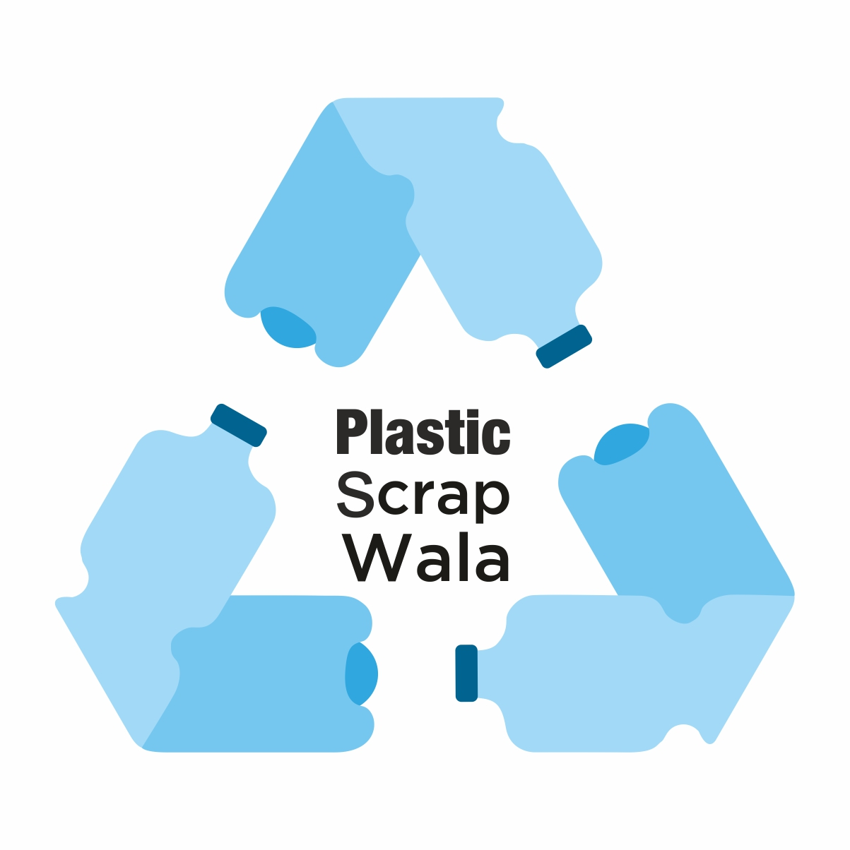
Price ◆ News ◆ Trade
The most reliable source for information and trade for the Plastic Recycling Industry in India.
Download from Play Store (for Android Users) and App Store (for iPhone Users)
Owned and Operated by:
Kalpataru Polymer Pvt. Ltd.

Slide 2
Brief history and current focus
Started in Nov’17 to provide price and news information in one polymer type i.e., PET
In Jan’20 and began providing price, news information for all polymer types PET, PP, HDPE, LDPE, PVC, etc.
Done a lot of work in information enablement. Currently, focusing on rolling out solutions for trade enablement
Introduced Market
Advisory and other
modules including
Solutions to facilitate
trade via Directory,
Live! Buy Sell Offers

Slide 3
Our Coverage Universe
We provide Quantitative data for:
We provide indicative prices for 158 products in the plastic recycling complex. These prices are updated daily.
We also provide news and analysis on these products as stated below.
We provide Qualitative data for the below Product Segments: | Time frequency at which the alongside data is delivered / updated
PET Bottle, Flakes, Fibre, Yarn, Chips, Popcorn, Strap | Weekly
PP Scrap and Dana Raffia, Jumbo Bag, Injection Mold | Weekly
HD Scrap and Dana Crate, Drum, Blow, Pipe | Weekly
LD Scrap and Dana Film, Glucose | Weekly
LLD Scrap and Dana Film, Syntex, Drip | Weekly
PVC Scrap & Dana Pipe, Cable | Weekly
ABS Scrap and Dana Injection Mold | Weekly
HIPS Scrap and Dana Injection Mold | Weekly
Virgin PP HD LD LLD PVC | Weekly
Import & Export Data | Monthly

Slide 4
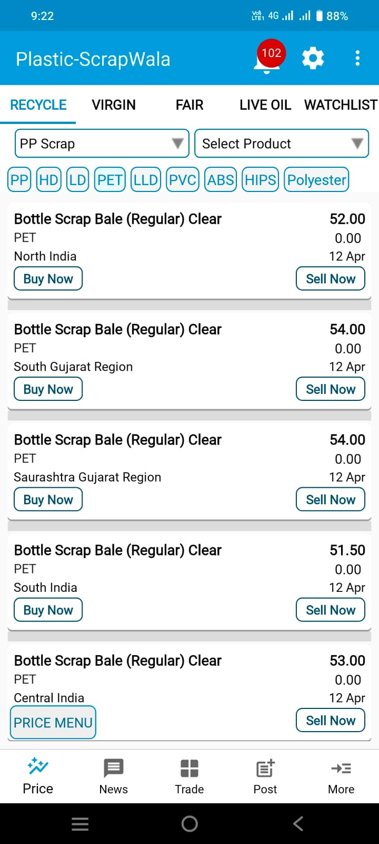
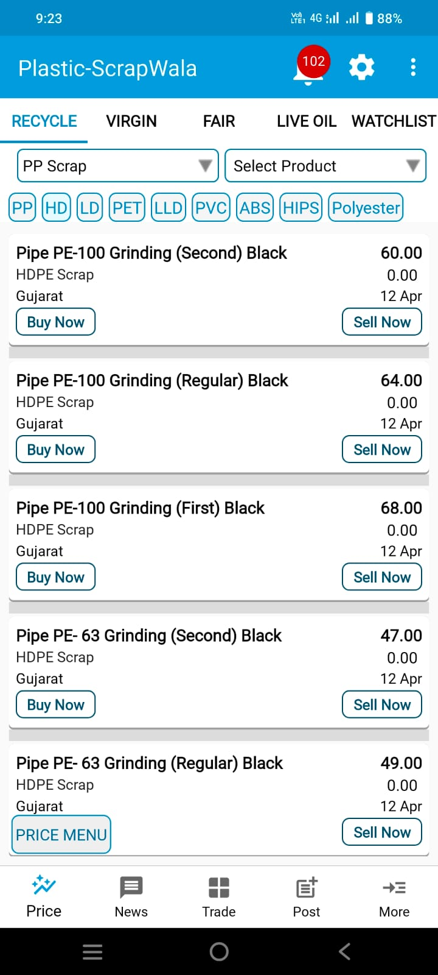
1. Plastic Scrap and Recycle Dana Prices (slide 1 of 2)
We provide comprehensive pricing information for major plastic scrap grinding and bales, alongside recycled Dana (Granules) prices in India. Additionally, you can find prices for polyester fiber, yarn, and polyester waste, along with historical data from the past two months. Our platform serves as a benchmark, enabling industries to make informed pricing decisions efficiently.

Slide 5
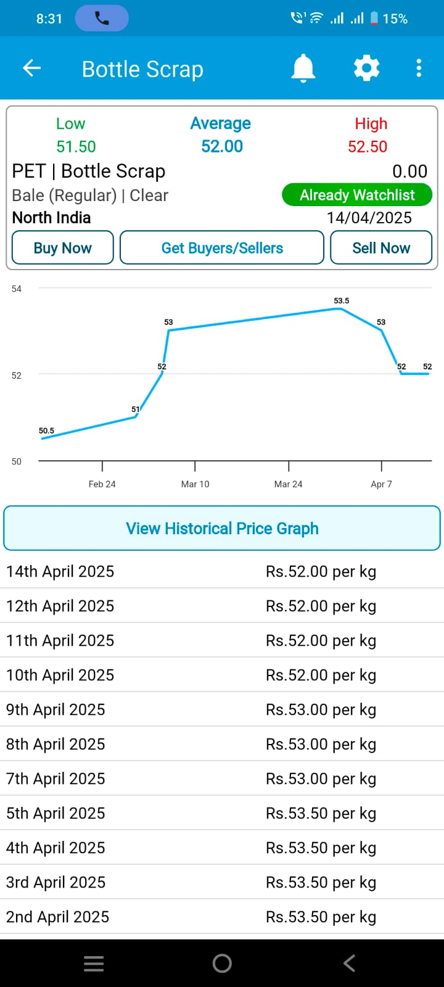
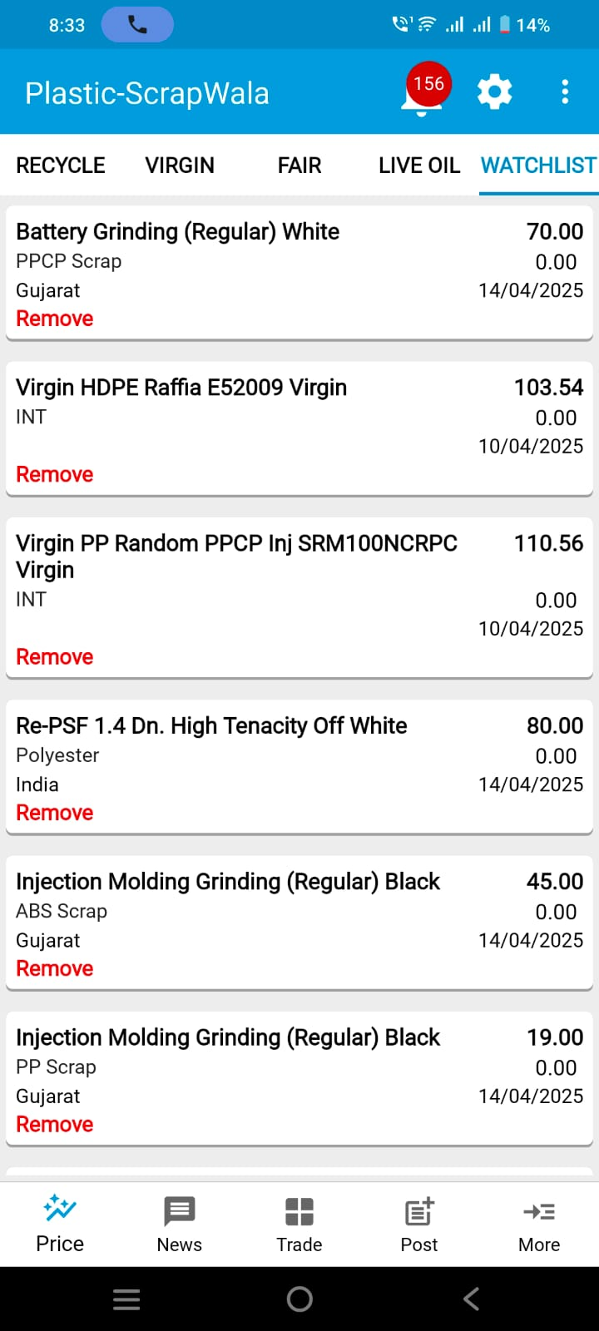
1. Plastic Scrap and Recycle Dana Prices (slide 2 of 2)

Slide 6
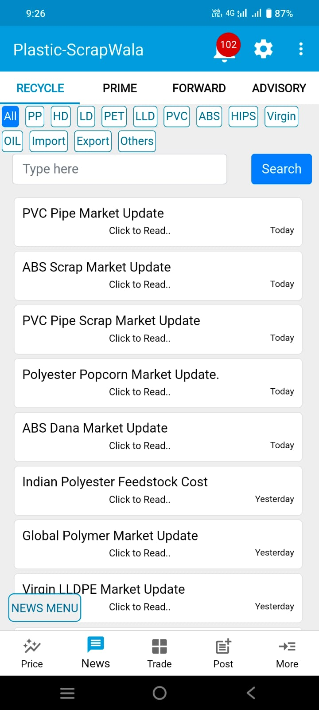
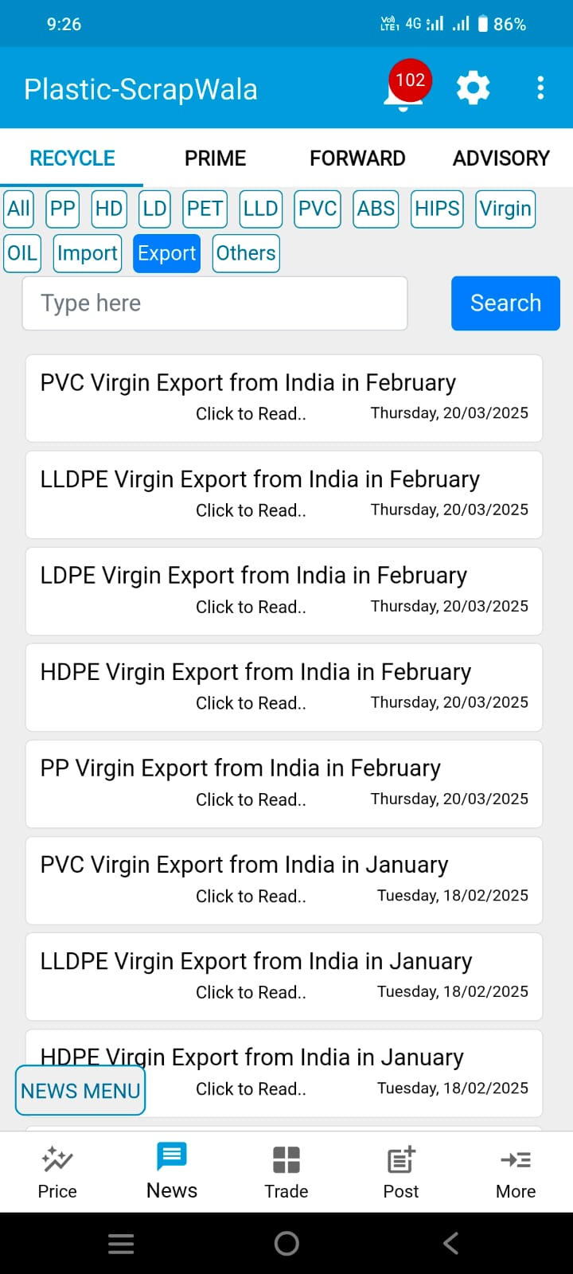
2. Recycle News (slide 1 of 3)
We offer weekly news updates on every recycled plastic scrap, recycled plastic granules, and end-product made from recycled plastic granules.
The weekly news update includes India’s plastic recycling market's demand and supply, factors influencing pricing and fundamentals.
We also give (i) weekly analysis of virgin granules for all polymers and (ii) import-export data for virgin granules and recycled scrap and granules.
Weekly announcements of price changes from Reliance Industries Limited (RIL) and global price trends for virgin plastic granules.

Slide 7
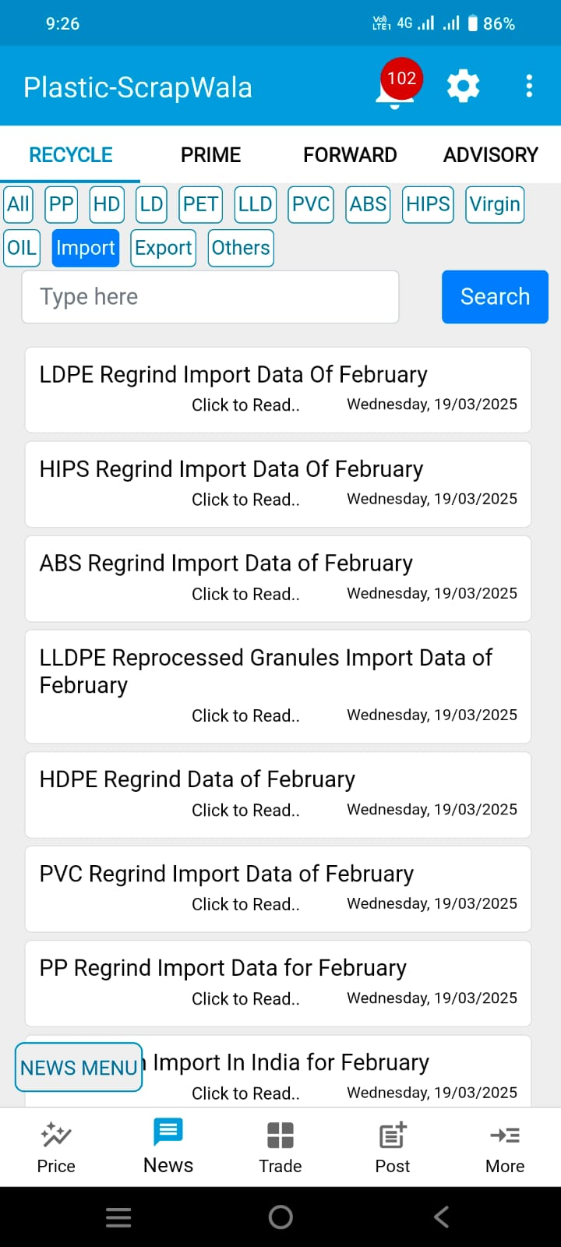
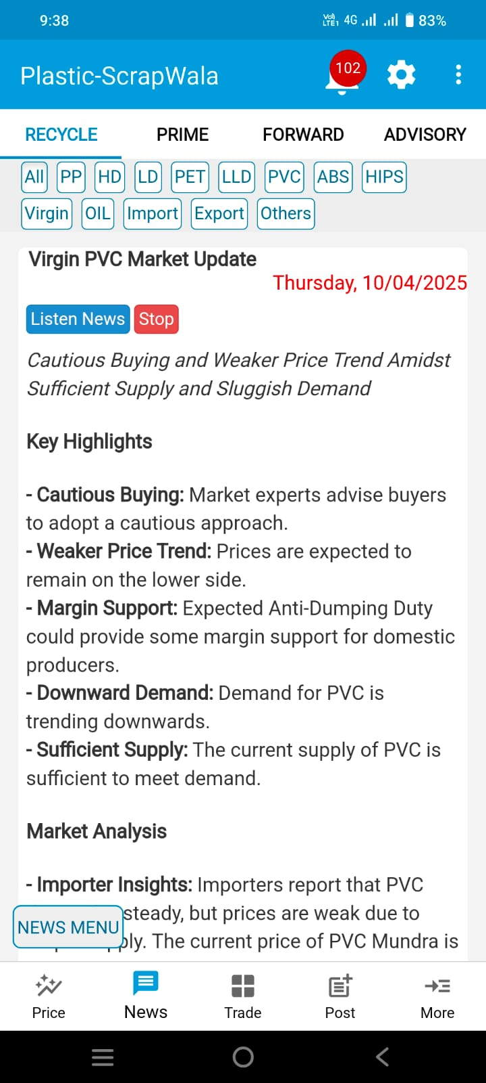
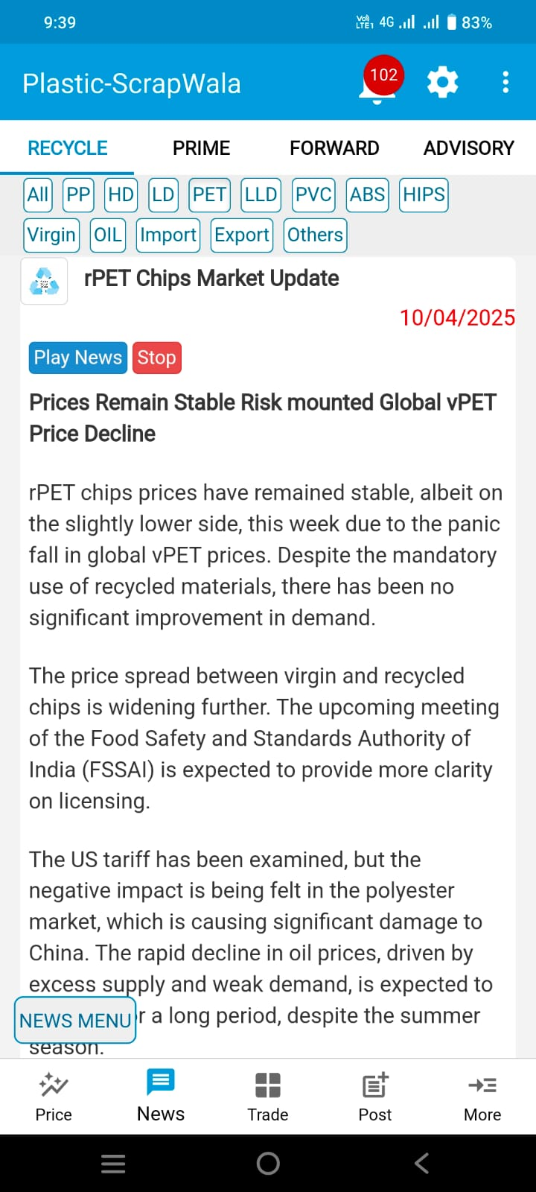
2. Recycle News (slide 2 of 3)

Slide 8
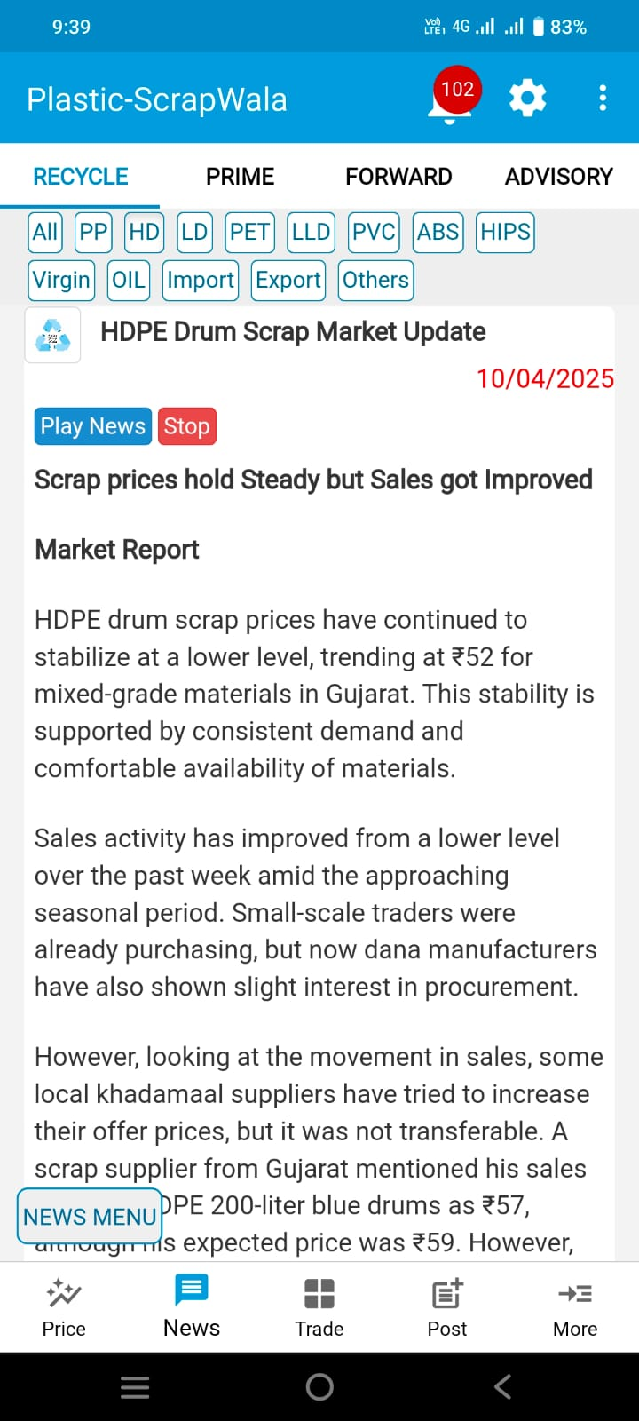
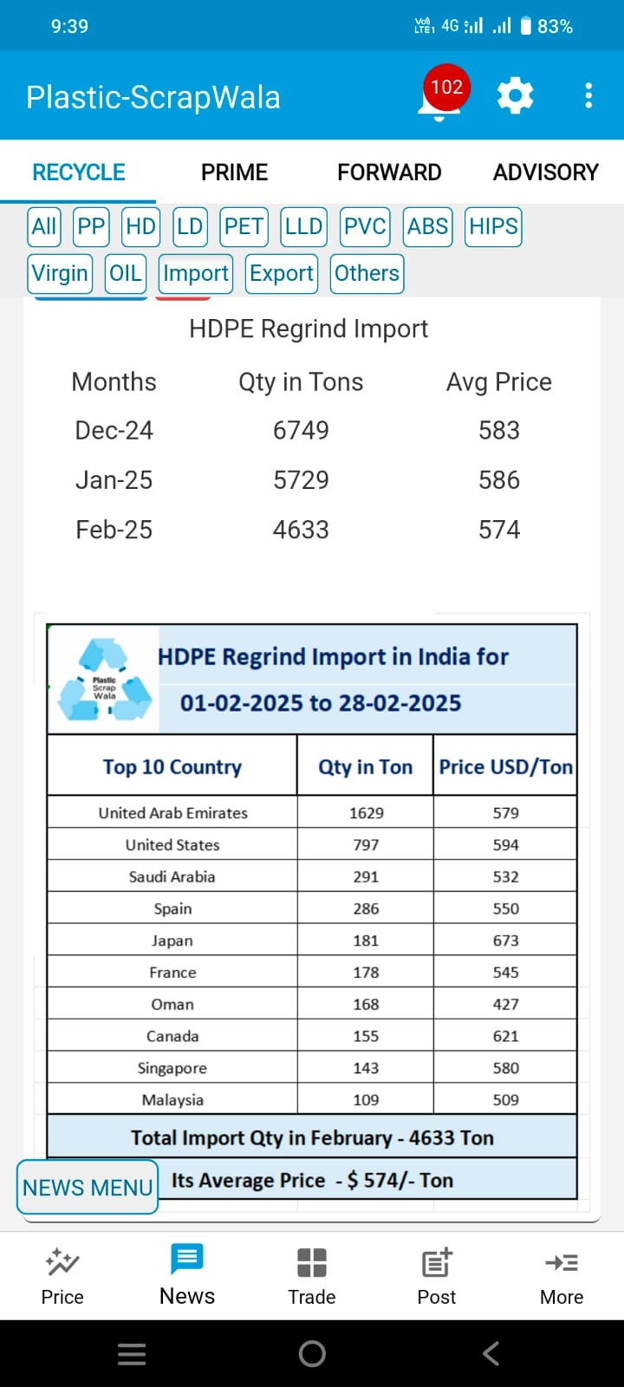
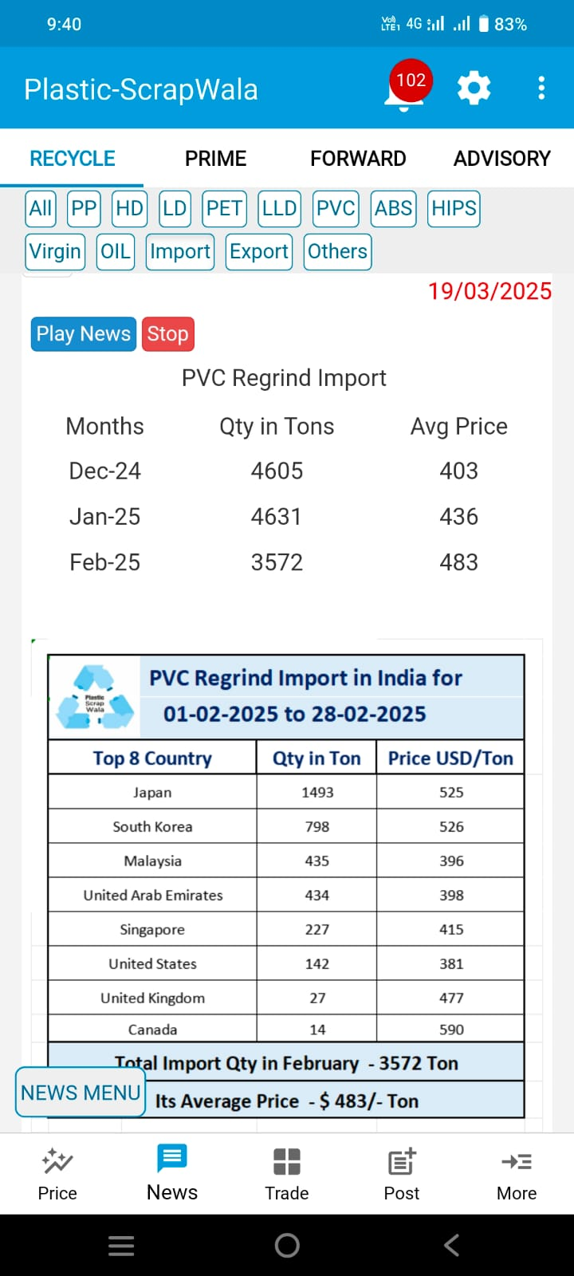
2. Recycle News (slide 3 of 3)

Slide 9
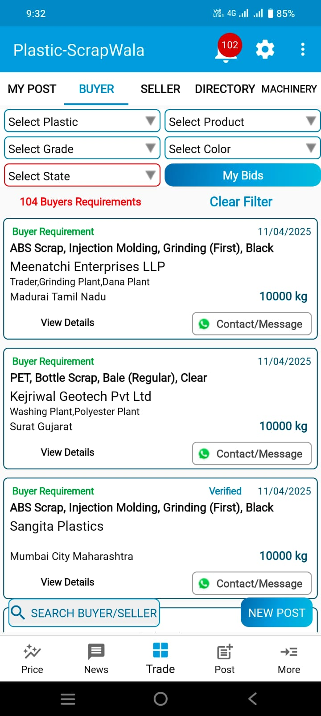
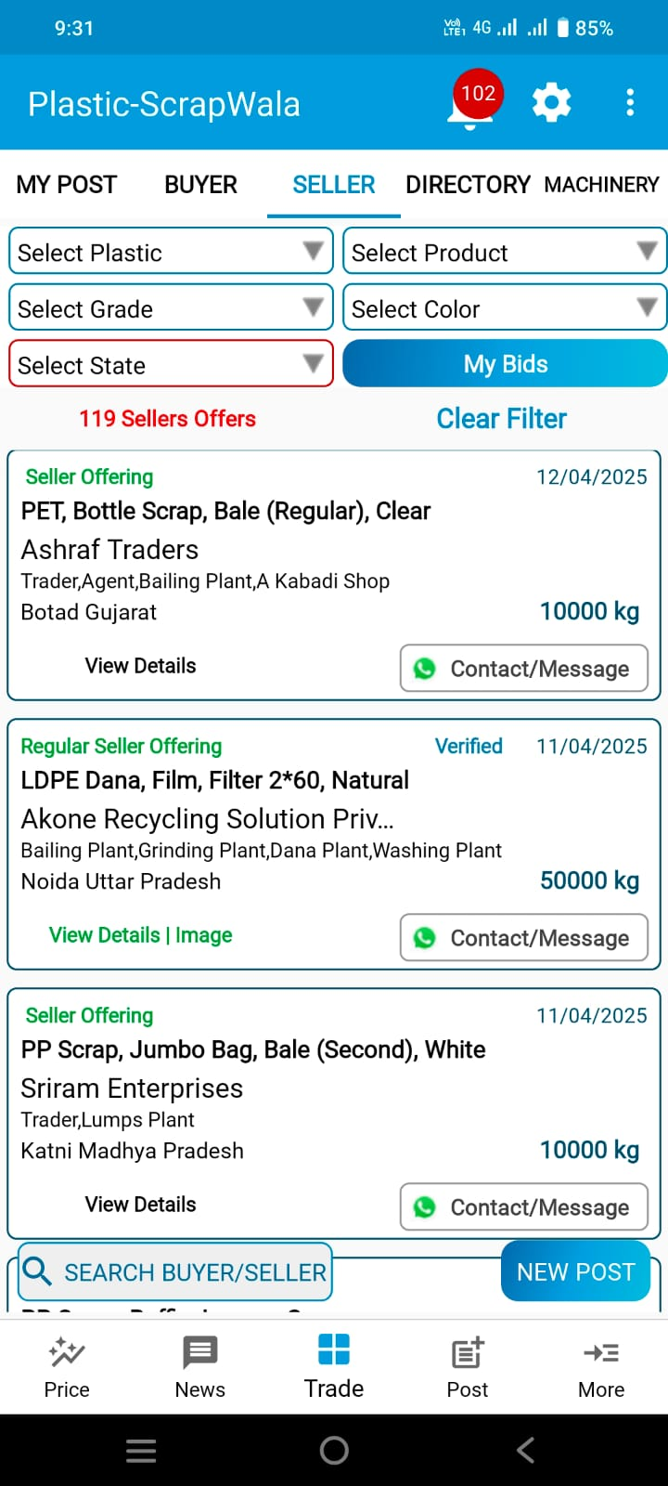
3. Buyer – Seller Contact (slide 1 of 2)
This open marketplace allows users to freely post their requirements for
(i) recycled plastic scrap; and
(ii) recycled plastic granules.
There are thousands of offers available to buy, sell, and connect with plastic scrap and recycled plastic granule suppliers across India.

Slide 10
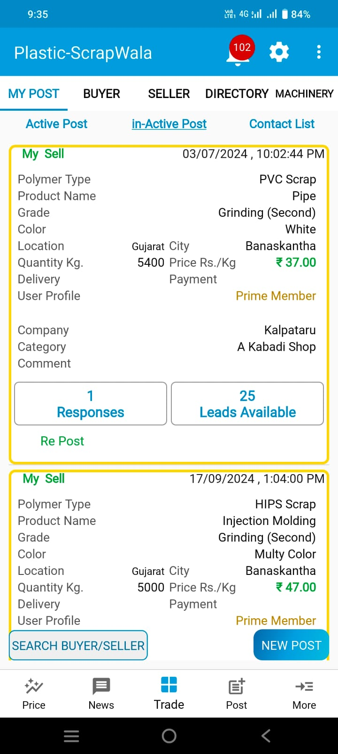
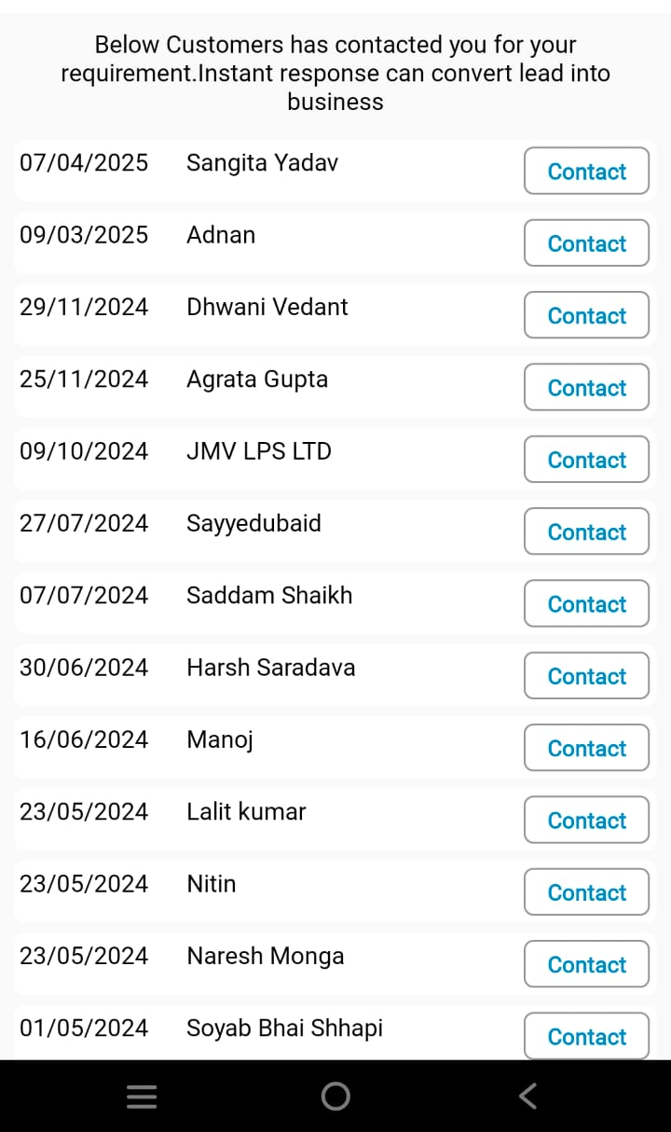
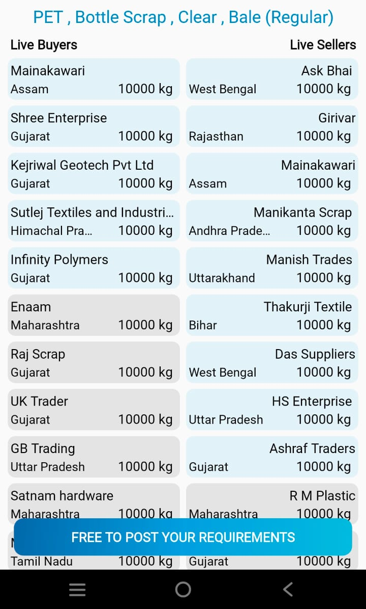
3. Buyer – Seller Contact (slide 1 of 2)
You can also see Market Depth of any Product with Live! Buyers and Sellers.

Slide 11
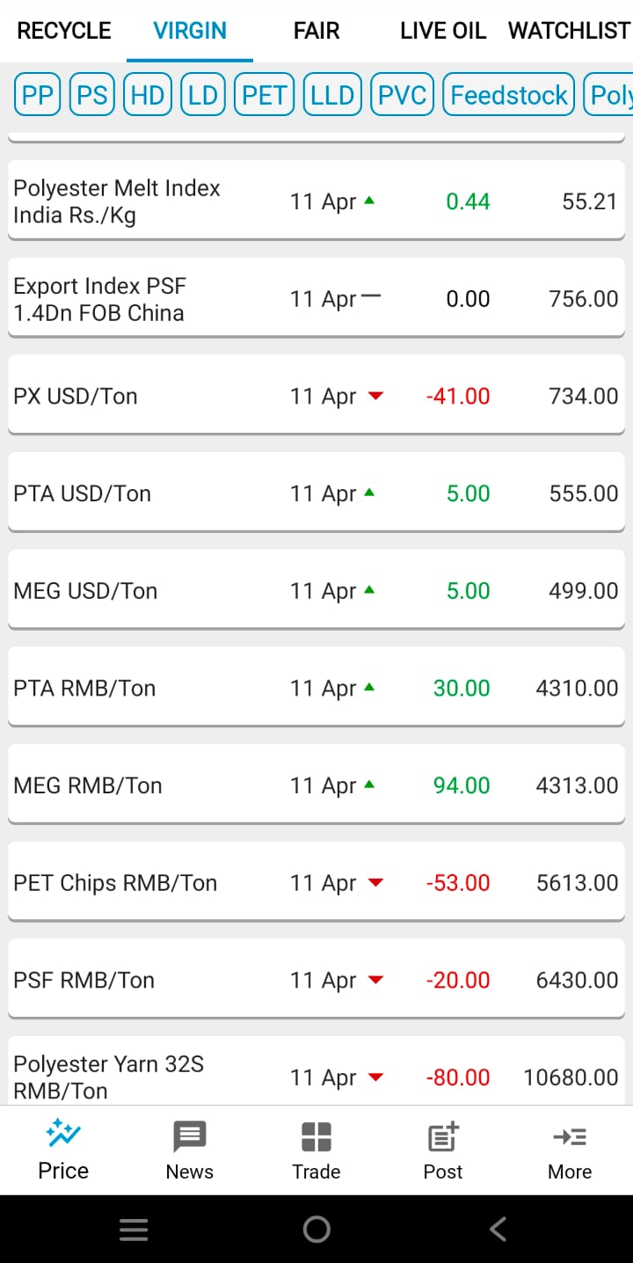
4. Virgin Price Information (slide 1 of 2)
We provide price list of
feedstock (Propylene, Ethylene, PTA, MEG, PX, etc.);
virgin granule prices; and
daily reference prices for polyester fiber, yarn, polyester melt, and PSF export indices
Real-time updates on oil and currency prices are also available,
Futures prices of all Polymers.

Slide 12
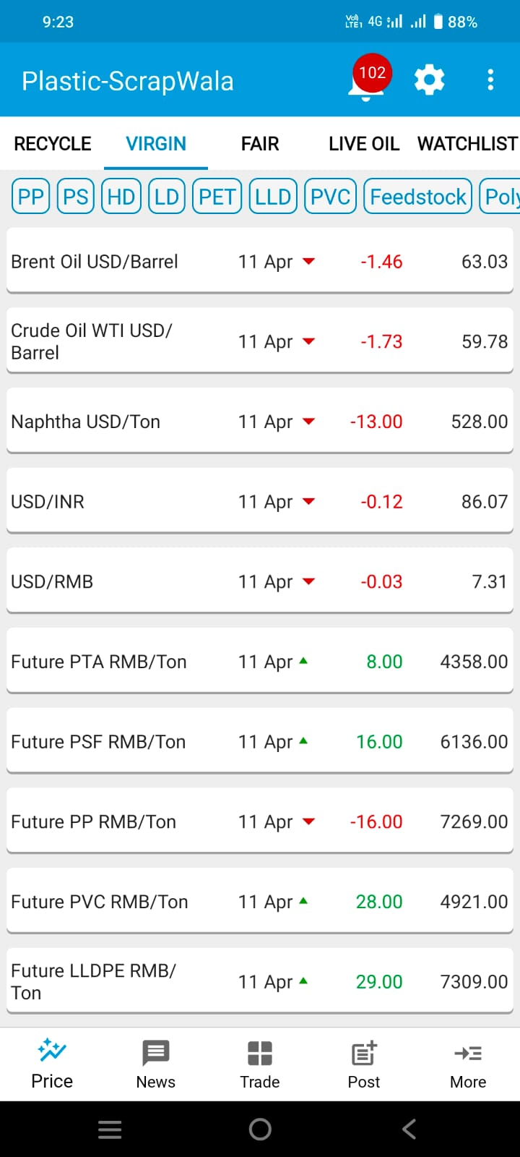
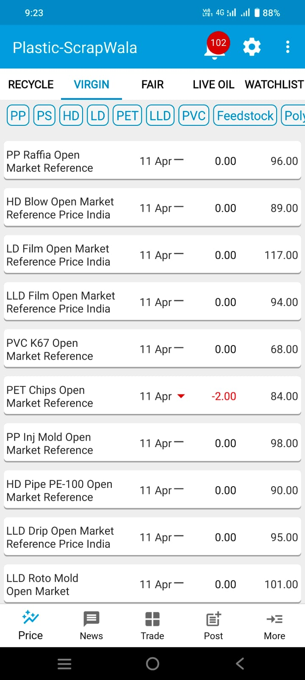
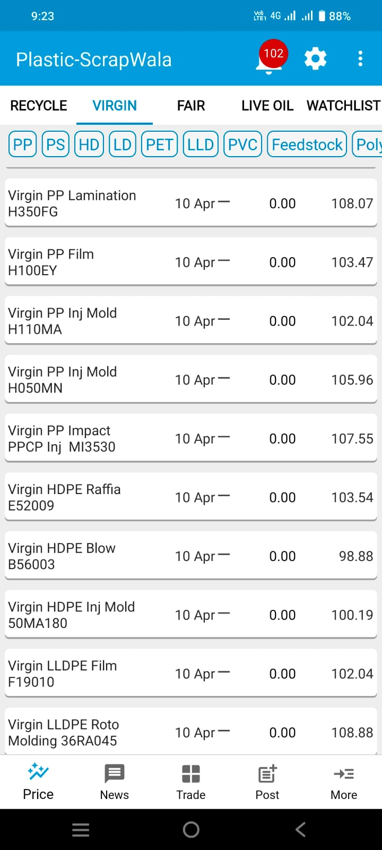
4. Virgin Price Information (slide 2 of 2)

Slide 13
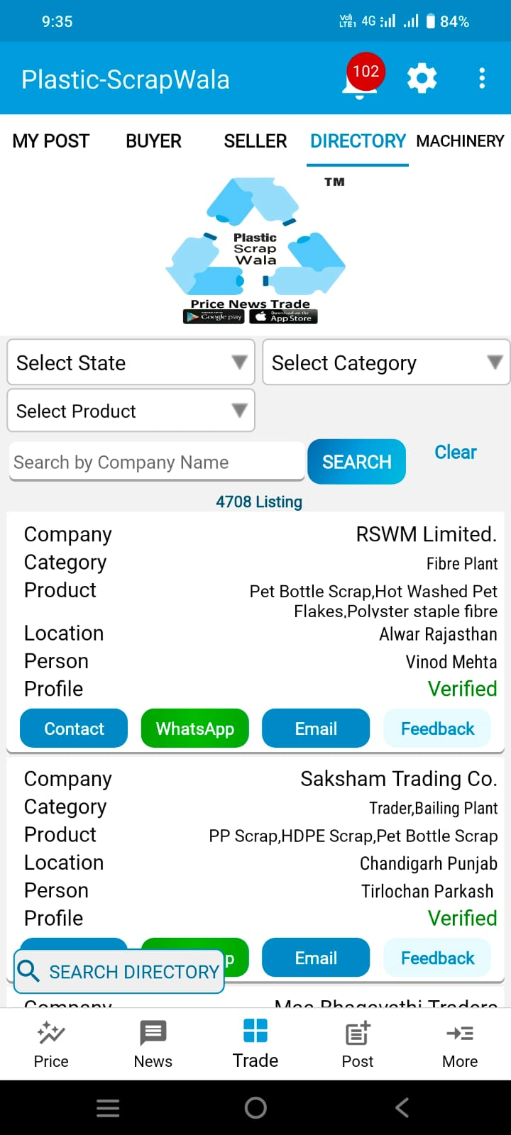
5. Companies Directory
We have compiled a comprehensive database of over 5,000 companies in the recycling industry.
The Directory also includes over 1,500 companies that are verified by the Plastic-ScrapWala team.
Companies are categorized by polymer type and business structure, such as washing plants, dana plants, grinding plants, and baling plants.
Users can contact these companies directly.
These companies are categorized as per their business model like dana plant, molding plant, blowing plant, film plant, pipe plant, etc. more than 30+ categories are added as per plant type.

Slide 14
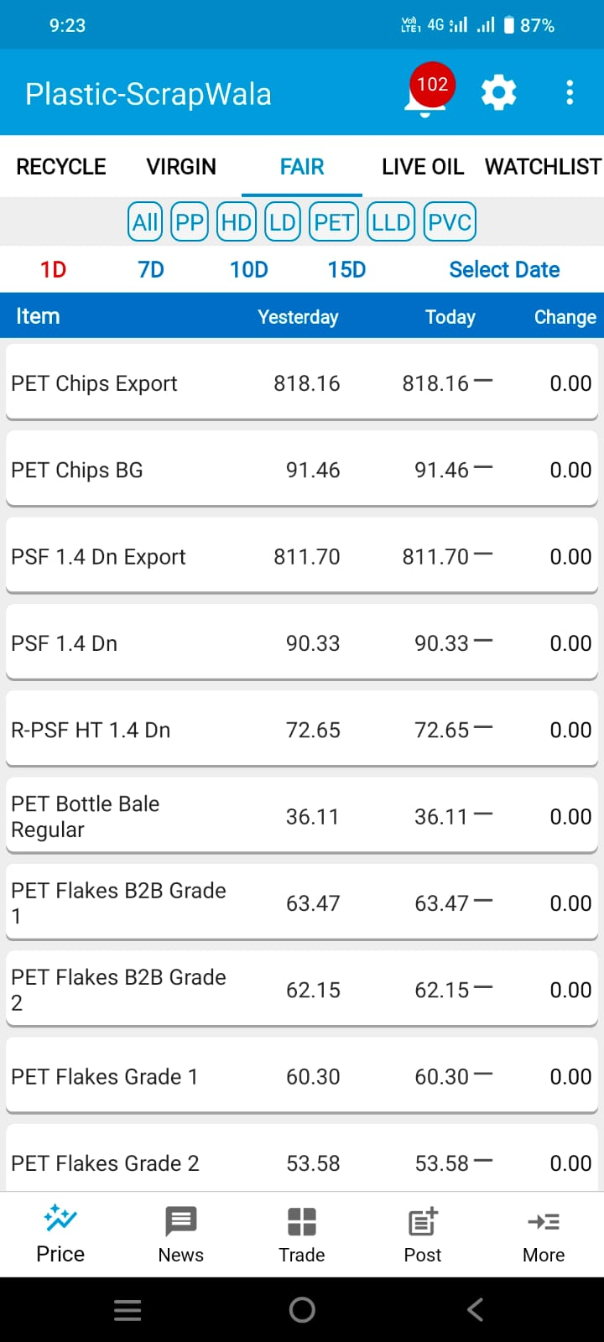
6. Fair Price (slide 1 of 2)
We publish indicative (theoretical) fair prices of PP, HD, LD, LLD, PVC and PET granules prices for virgin and recycled both. These are derived mathematically and regulary updated with respect to changes in prices of Crude and Crude derivatives (Naphtha, PX, PTA, MEG, Propylene, Ethelene, etc.) that act as feedstock to produce different types of polymers.
This allows users to make timely market decisions in the short-term (without waiting for RIL’s weekly updates).
This also gives opportunity to compare discount and premium from Spot price to predict prices in the medium-term.

Slide 15
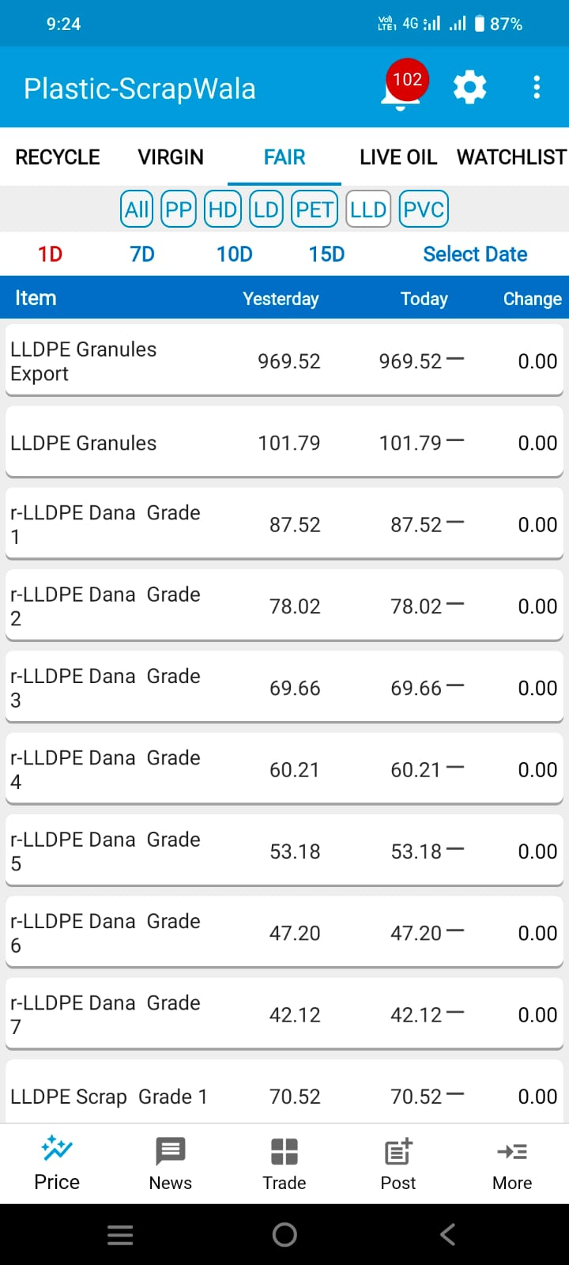
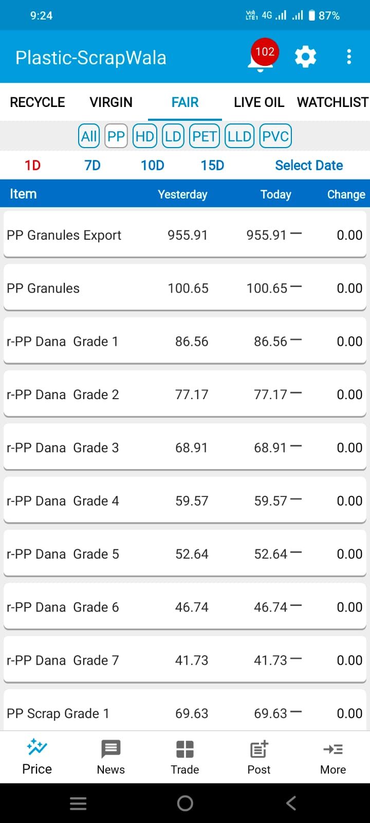
6. Fair Price (slide 2 of 2)

Slide 16
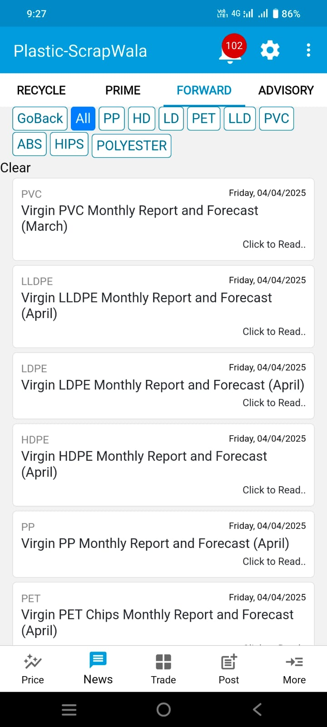
7. Forward Virgin Analysis (slide 1 of 2)
This is a monthly update on Virgin polymers like PET, PP, HD, LD, LLD and PVC.
The analysis focuses on month-on-month change in (theoretical) fair price and (actual) Spot prices with Premium and Discount analysis.
Also, we comment on factors driving demand and supply that ultimately drive the price for Virgin Polymers.
We also provide our to help our client take strategic decision on whether to focus on buying or selling. This analysis is available at the beginning of each month.

Slide 17
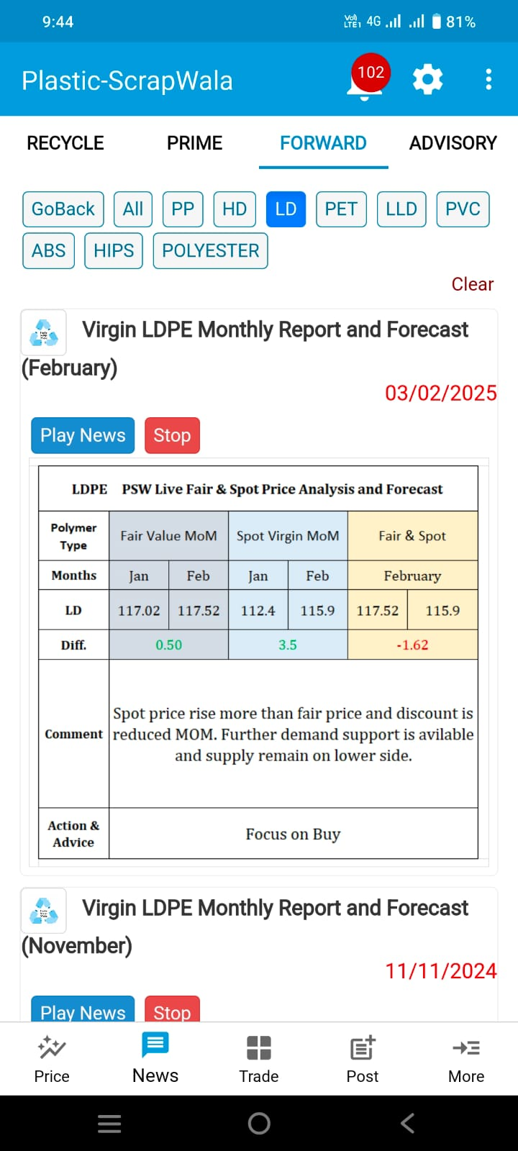
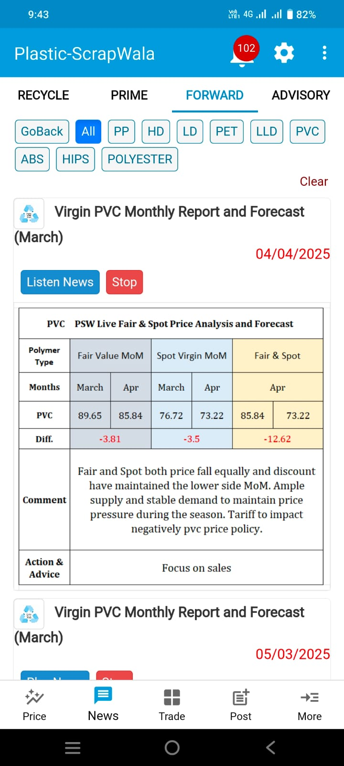
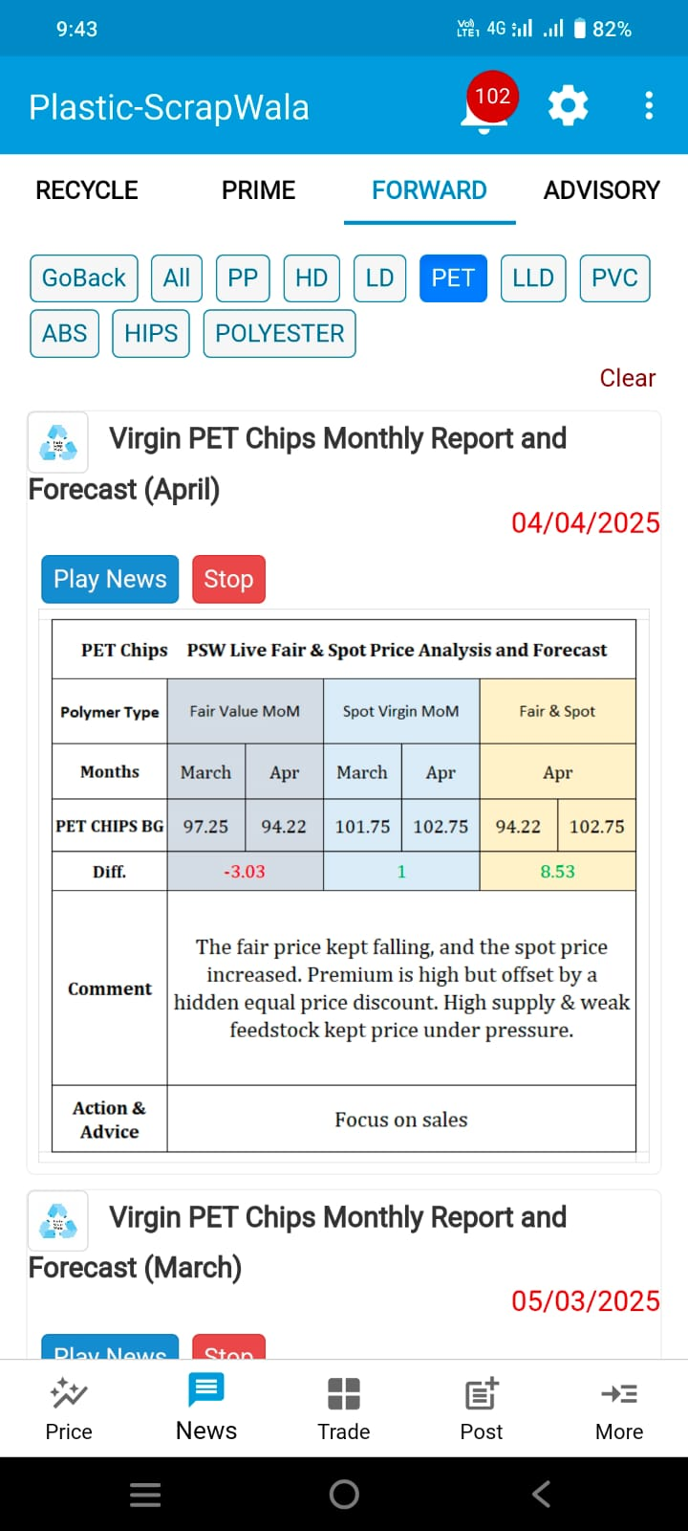
7. Forward Virgin Analysis (slide 2 of 2)

Slide 18
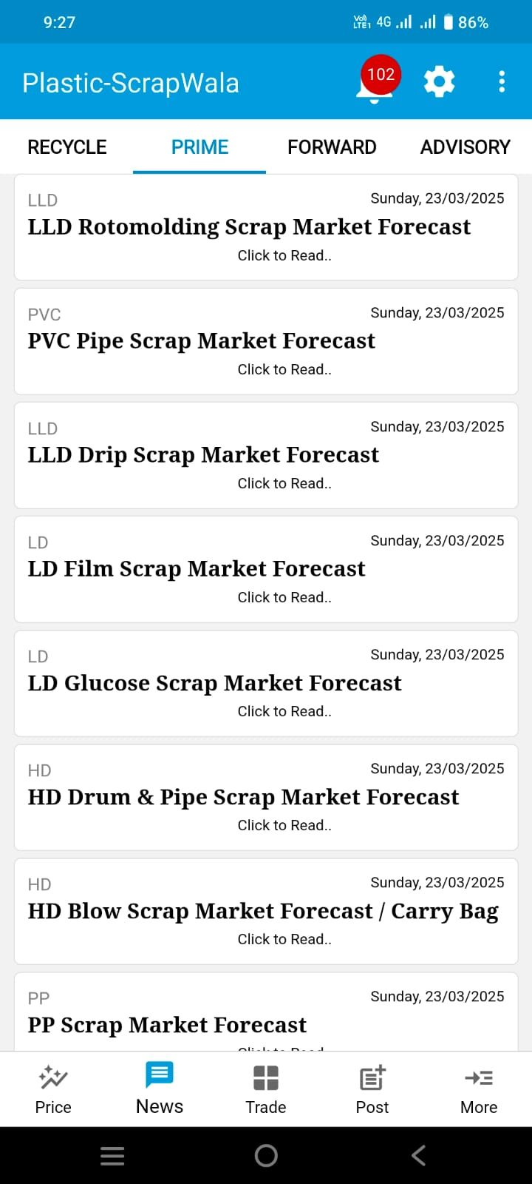
8. Forward Scrap – Prime News (slide 1 of 2)
This is a monthly update where we provide price forecast of plastic scrap like PET bottle scrap, HDPE bottle scrap, HDPE drum, LDPE film scrap, PVC pipe scrap, LLDPE syntex scrap, PP article scrap, etc.
This update also includes our comments on local demand and supply and other drivers that affect prices of plastic scrap across all polymers.
Each product type above will have a separate monthly update with price forecast and forward-looking commentary.

Slide 19
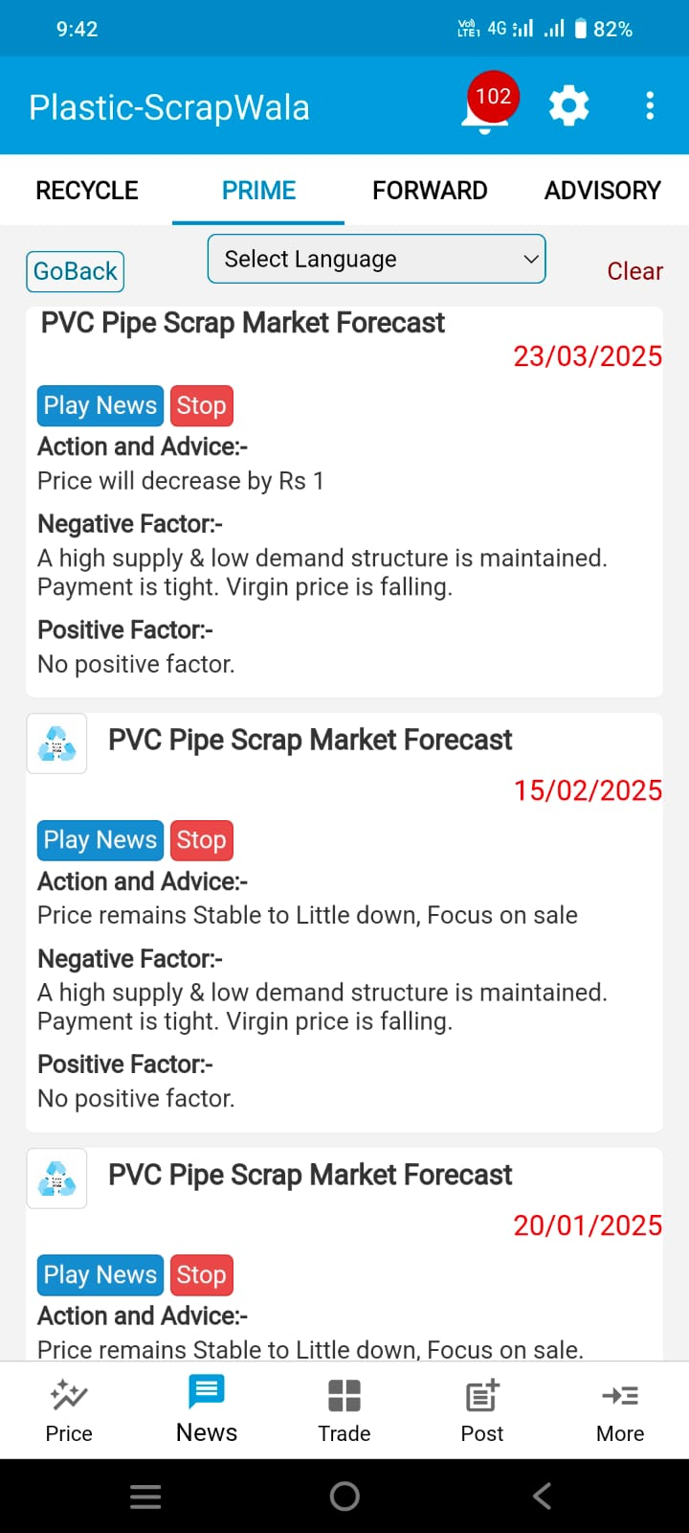
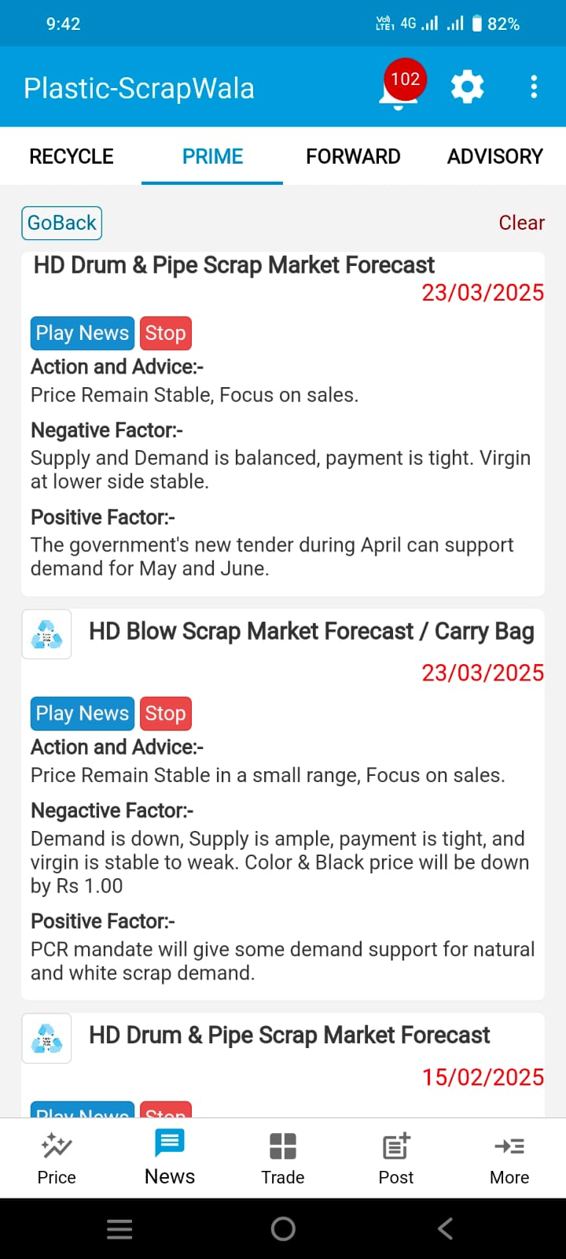
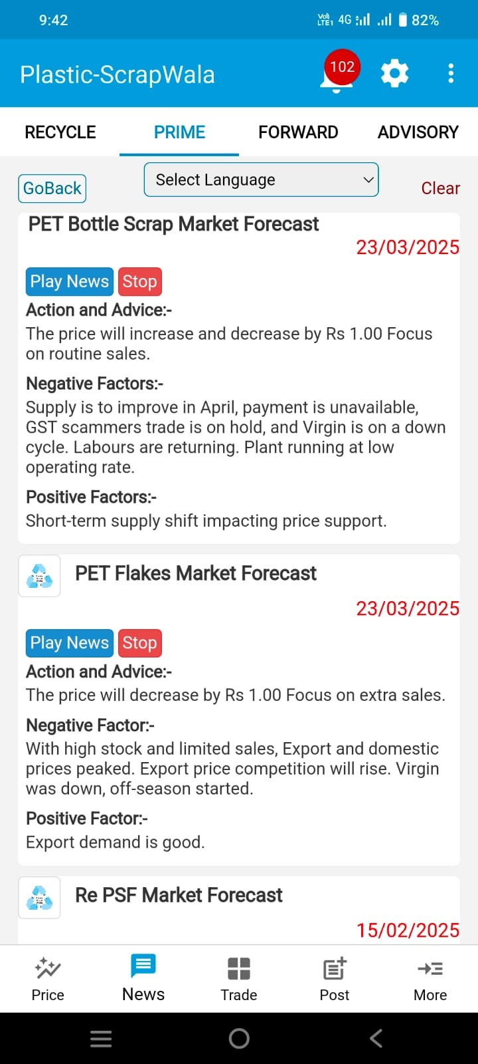
8. Forward Scrap – Prime News (slide 2 of 2)

Slide 20
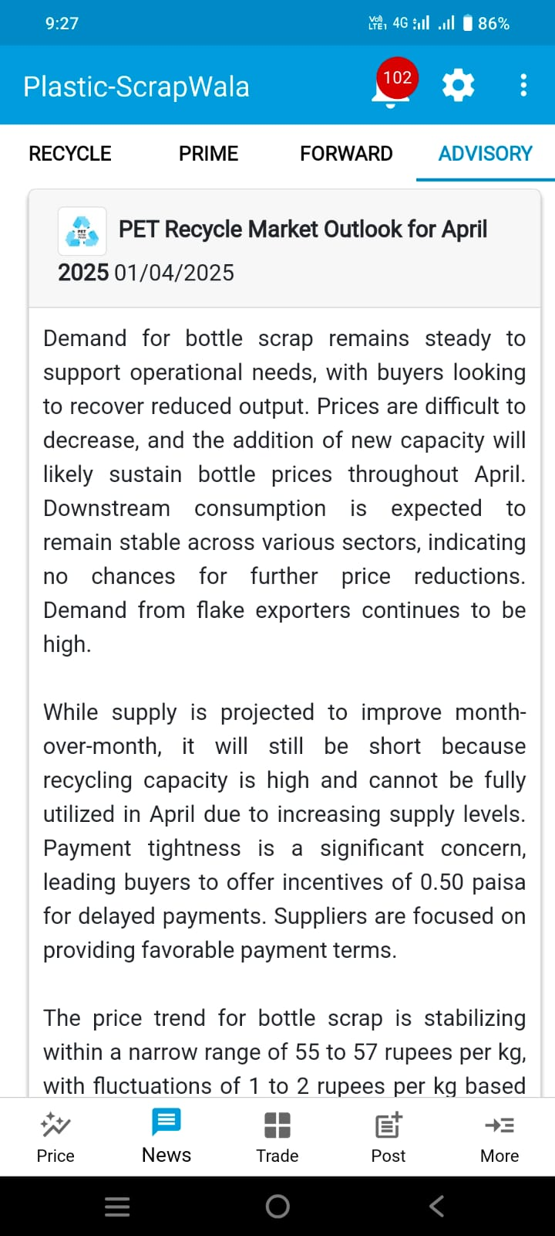
9. PET - Advisory
This is a very detailed report on PET Bottle Scrap market of India. We give demand outlook for the PET bottle scrap with comments on improvement in demand and reasons for the same. Impact analysis of demand variables on future prices in the short-term.
Additionally, we also provide Supply outlook in the PET bottle scrap market of India with comments on factors that drive supply.
We comment on consumption levels of downstream products to gauge demand of these downstream products.
We also give possible risk scenarios that can affect price forecast and suggest to keep an eye on critical factors.
We conclude this monthly update with a clear view on our estimate of PET bottle scrap prices in the short-term.

Slide 21
For future business strength – Remian Informed!

Slide 22
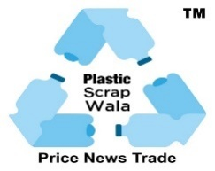
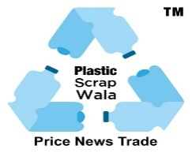
 |  |  |  |  | Subscription Plans (Plastic Scrap Wala)
 |  |  |  |  | Gateway to Your Business Growth.
 | Plan | Standard Charge / Discount |  |  |  | Rs Monthly | Services | USD Yearly (Out of India) | Discription
 | Plan 1 | 4800 Yearly | 25 % Discount | 3600 Yearly | 25 % Discount | 300 Monthly | 1) Scrap Price | $200 | PET, PP, HD, LD, LLD, PVC, PS, ABS Grinding & Bale
 | Plan 2 | 12000 Yearly | 20 % Discount | 9600 Yearly | 20 % Discount | 800 Monthly | 1) Scrap Price | $300 | RIL list & Open Market, Feedstock, China Future Price
 |  |  |  |  |  |  | 2) Dana Price
 |  |  |  |  |  |  | 3) Virgin Prices
 |  |  |  |  |  |  | 4) Live! Oil Currency Price
 | Plan 3 | 18000 Yearly | 33 % Discount | 12000 Yearly | 33 % Discount | 1500 Monthly | 1) Scrap Price | $400 | All New & Old Buy & sell leads Pan India
 |  |  |  |  |  |  | 2) Dana Price
 |  |  |  |  |  |  | 3) Virgin Prices
 |  |  |  |  |  |  | 4) Live! Oil Currency Price
 |  |  |  |  |  |  | 5) Buyer Seller Contact
 |  |  |  |  |  |  | 6) Used Machinery
 | Plan 4 | 21000 Yearly | 28 % Discount | 15000 Yearly | 28 % Discount | 1800 Monthly | 1) Scrap & Dana Price | $500 | Demand Supply Trend Risk Opportunity Analysis, Import & Export Data, Virgin Trend, Delhi Aadhat Price,
 |  |  |  |  |  |  | 2) Virgin Prices
 |  |  |  |  |  |  | 3) Buyer Seller Contact
 |  |  |  |  |  |  | 4) Live! Oil Currency Price
 |  |  |  |  |  |  | 5) Used Machinery
 |  |  |  |  |  |  | 6) Recycle News Analysis
 |  |  |  |  |  |  | 7) Virgin News Research
 |  |  |  |  |  |  | 8) Import Export Report
 | Plan 5 | 30000 Yearly | 16.60 % Discount | 25000 Yearly | 16.60 % Discount |  | Plan 4 + | $600 | Verified Buyers & Suppliers
 |  |  |  |  |  |  | Companies Directory
 |  |  |  |  |  |  | All India Virgin & Recycle
 |  |  |  |  |  |  | Suppliers, Recyclers, Manufactures
 | Plan 6 | 80000 Yearly | 40 % Discount | 48,000 Yearly | 40 % Discount | Additional per user Rs. 11800 | Plan 5+ | $800 | Premium & Discount Analysis & Price Forecast for Scrap & Virgin.
 |  |  |  |  |  |  | 1) Fair Price (AI)
 |  |  |  |  |  |  | 2) Forward Analysis
 |  |  |  |  |  |  | 3) Prime News
 |  |  |  |  |  |  | 4) Prime TAG in Post
 | Plan 7 | 6,00,000 Yearly | 16 % Discount | 5,00,000 Yearly | 16 % Discount | 5 User Access | 1) Plan 6+ 2) Market Advisory 3) Historical Graph 2 Years | $6000 | Improve Your Trade Decision with Expert Advice—direct Talk to Experts.
 | Plan 8 | 40,000 Yearly | 25 % Discount | 30000 Yearly | 25 % Discount |  | 2) Historical Graph 2 Years (Scrap, Dana and Virgin) | $700 | Resource for analysis, examining Past price patterns & behavior.
 | Your Reliable Business Growth Partner (Plastic Scrap Wala)

